Slide 1

OSMANIA UNIVERSITY
WELCOME TO
ONLINE ATTENDANCE
GUIDELINES/INSTRUCTIONS

Slide 2
WEBLINK
ENTER THE BELOW WEBSITE ADDRESS IN THE WEBBROWSER OF YOUR COMPUTER
http://portal.osmania.org.in

Slide 3

FOLLOWING SCREEN WILL BE DISPLAYED
ENTER USER ID AND PASSWORD SENT TO YOU THROUGH SMS AND CLICK LOGIN.
HELP LINE NUMBERS ARE GIVEN IN THE ABOVE SCREEN, IN CASE YOU NEED HELP REGARDING ONLINE ATTENDANCE.

Slide 4
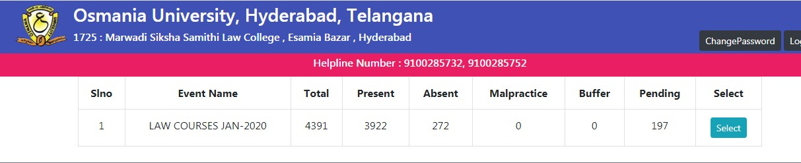
AFTER ENTERING USER ID AND PASSWORD OF YOUR CENTER FOLLOWING SCREEN WITH YOUR CENTER COURSES WILL BE DISPLAYED.
CLICK ON SELECT TO ENTER NEXT SCREEN.

Slide 5
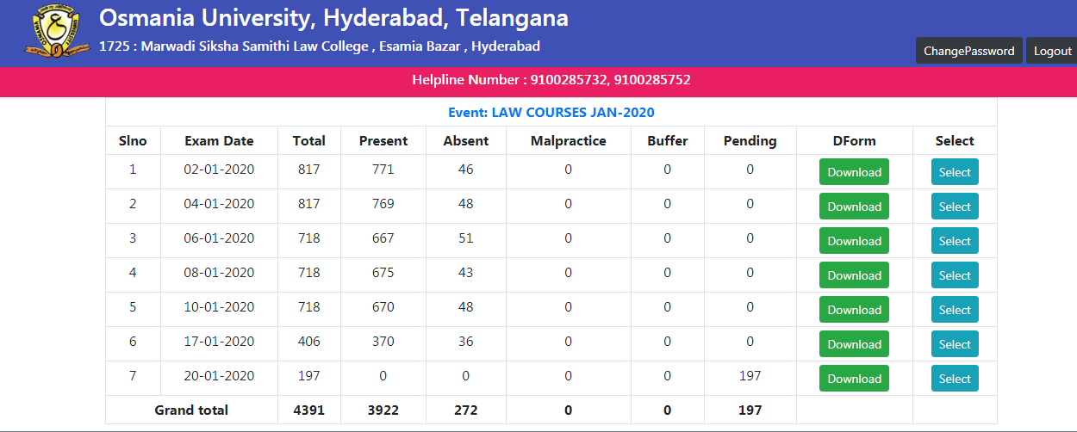
IN THE NEXT SCREEN EXAM DATE, ATTENDANCE INFORMATION IS GIVEN.
DOWNLOAD D-FORM(AS SHOWN IN IMAGE) AND TAKE PRINT OUT
PLEASE FIND BELOW SAMPLE D-FORM.

Slide 6
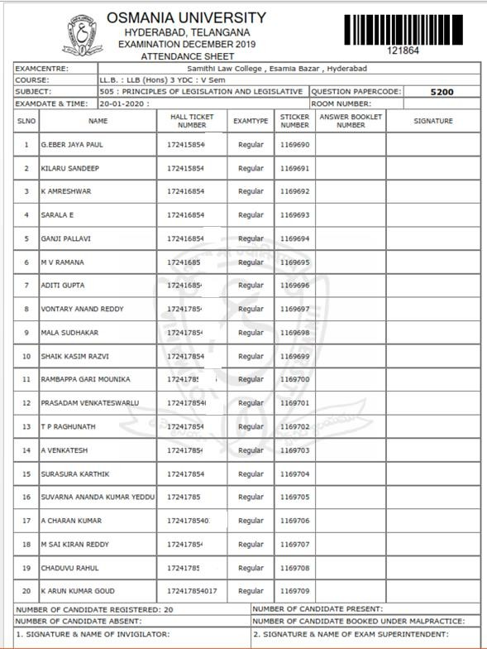
SAMPLE D-FORM

Slide 7
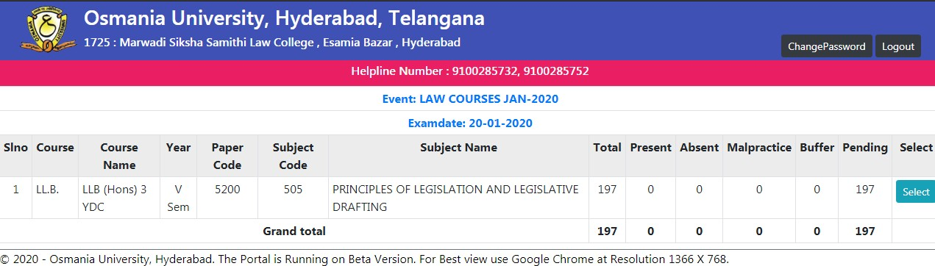
IN THE SAME SCREEN,CLICK ON “SELECT” (BESIDE D FORM DOWNLOAD BUTTON)ON PARTICULAR EXAM DATE TO ENTER NEXT STEP OF THE PROCESS.
THE FOLLOWING SCREEN IS DISPLAYED WITH COURSE AND SUBJECTS
CLICK ON “SELECT” BUTTON FOR PARTICULAR SUBJECT TO ENTER NEXT PROCESS

Slide 8
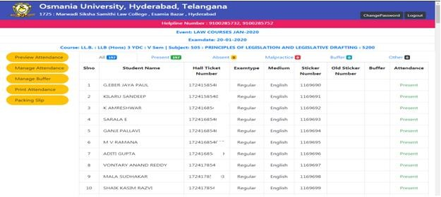
AFTER CANDIDATE’S SIGNATURE ON D FORM, FILL THE ATTENDANCE ONLINE IN THE FORMAT SHOWN IN BELOW SCREEN.
BY DEFAULT ATTENDANCE
IS MARKED MAL PRACTICE
PRESENT, SELECT ABSENT /
CANDIDATES IN THE DROP DOWN BOX OF FOR A PARTICULAR HALLTICKET NUMBER.
YOU CAN NUMBER
FIND THE ABSENT HALL TICKET BY ENTERING NUMBER IN
FIND(CTRL+F) DIALOG BOX.

Slide 9
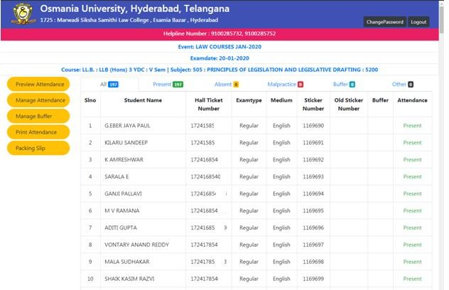
IN CASE OF EDITING OF ATTENDANCE OF ANY CANDIDATE CLICK ON “MANAGE
ATTENDANCE”

Slide 10
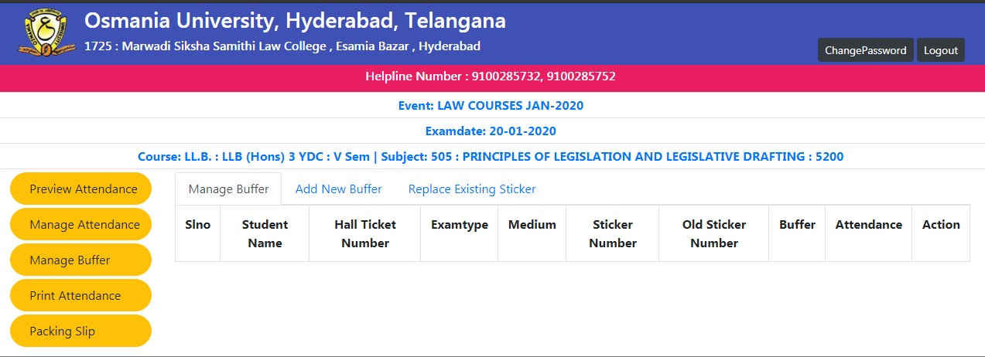
ADDING NEW BUFFER
FOR ADDING BUFFER CANDIDATES, CLICK ON “MANAGE BUFFER” BUTTON ON THE SCREEN AS SHOWN IN IMAGE BELOW.
AFTER CLICKING ON “MANAGE BUFFER” CLICK ON “ADD BUFFER” TO ENTER NEW BUFFER DETAILS.
SEE IMAGE BELOW TO ADD NEW BUFFER DETAILS

Slide 11
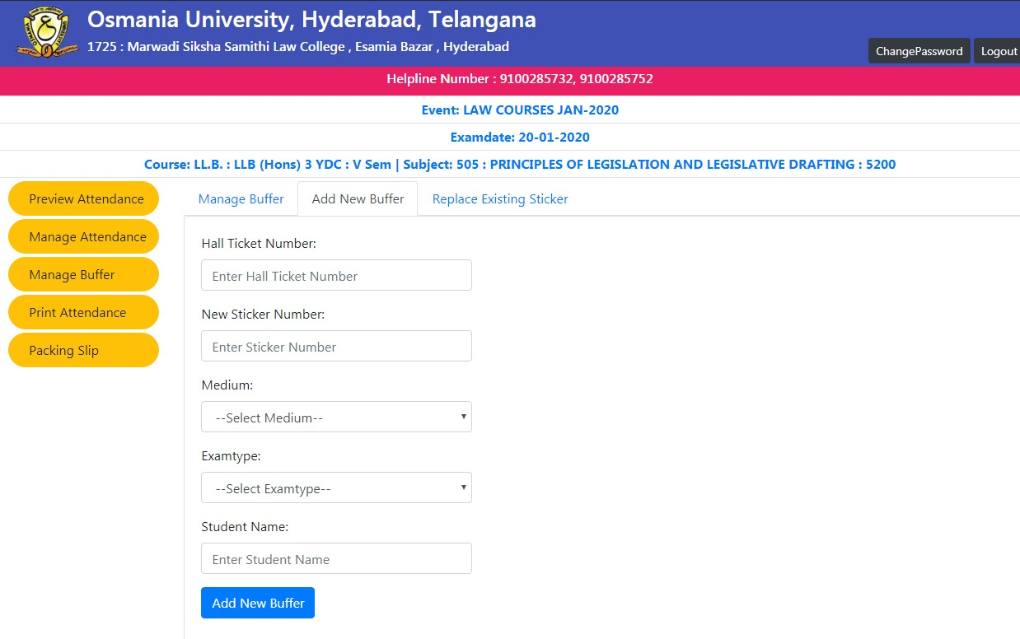
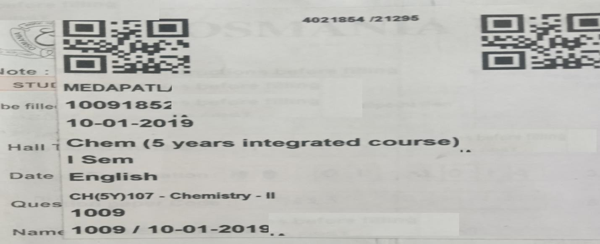
SAMPLE BUFFER STICKER. BARCODE NUMBER IS AS SHOWN IN IMAGE 4021854

Slide 12
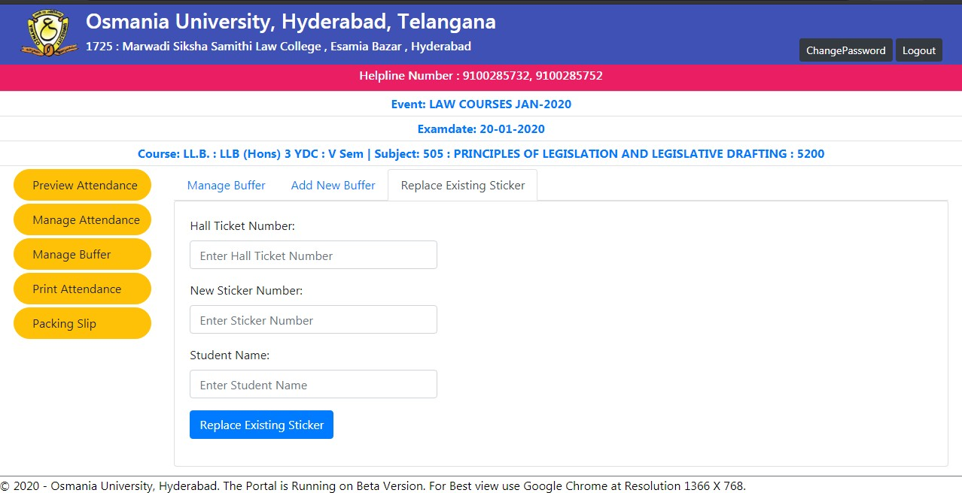
REPLACING EXISTING STICKER
CLICK ON “REPLACE EXISTING STICKER” IN CASE THE EXISTING STICKER IS DAMAGED, SMUDGED OR TORN.

Slide 13
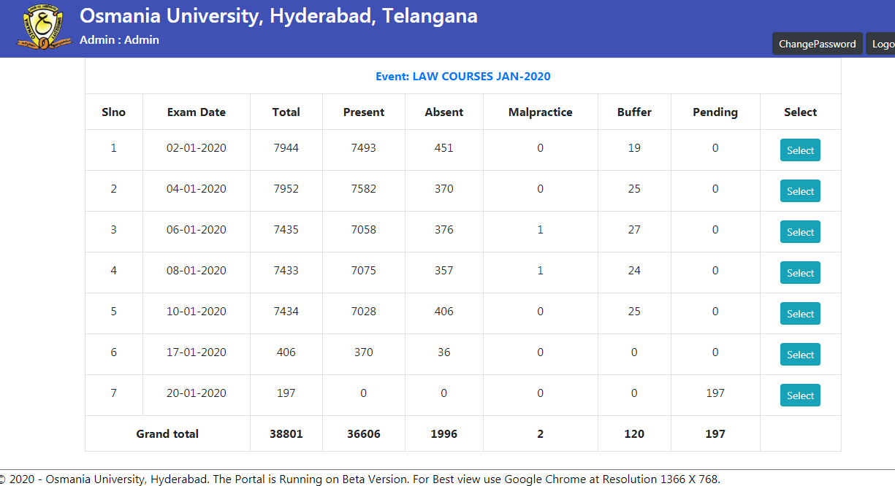
AFTER COMPLETING ATTENDANCE ENTRY ENSURE THE “PENDING STATUS” IN THE DATE WISE PAGE IS MADE ZERO. REFER BELOW IMAGE.

Slide 14
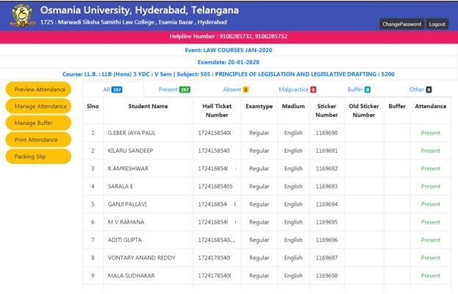
AFTER PENDING STATUS BECOMING ZERO, PROCEED WITH PACKING SLIP AS MENTIONED IN IMAGE.
CLICK ON PACKING SLIP BUTTON TO GENERATE THE SLIP. A SAMPLE FORMAT OF PACKING SLIP IMAGE IS DISPLAYED BELOW.

Slide 15
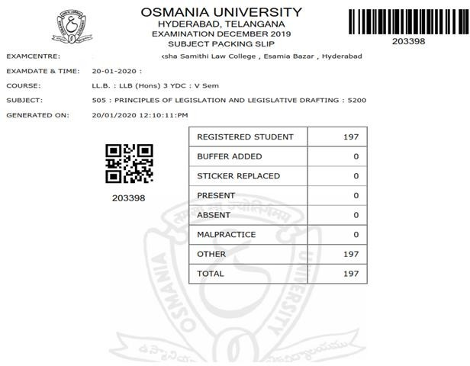
THANK YOU!

